Slide 1

EasyCleanMate: Efficient Memory Optimization Solution
Developed with C++ and WinUI

Slide 2
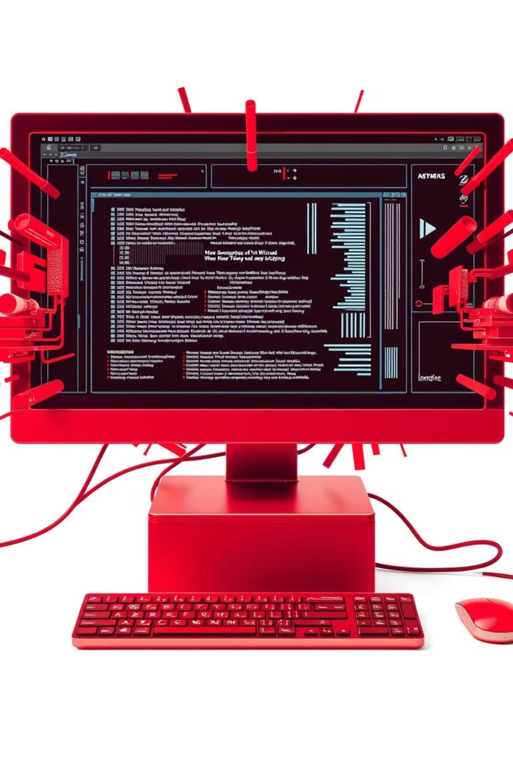
Why EasyCleanMate?
Slow performance and memory overload hinder productivity.
Our goal: a fast, intuitive solution for system optimization.

Slide 3



Project Requirements
Functional
Memory usage scanner
One-click cleaning
Visual feedback
illustrative
Non-Functional
Fast execution time
User-friendly UI
Windows compatibility

Slide 4

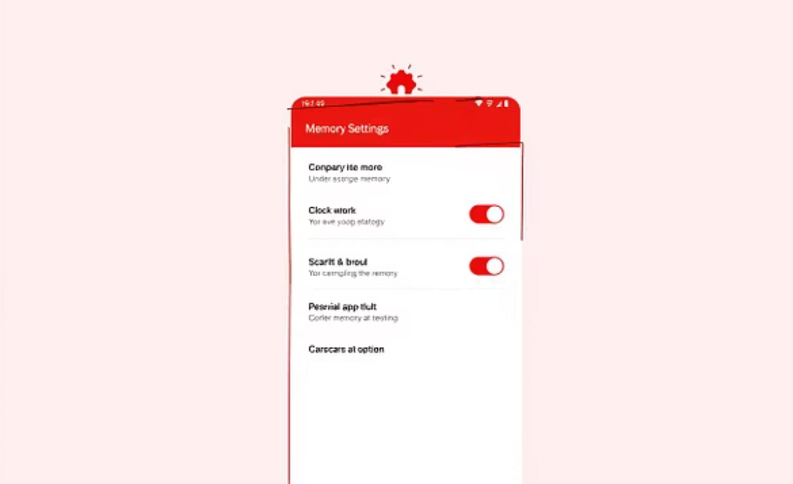
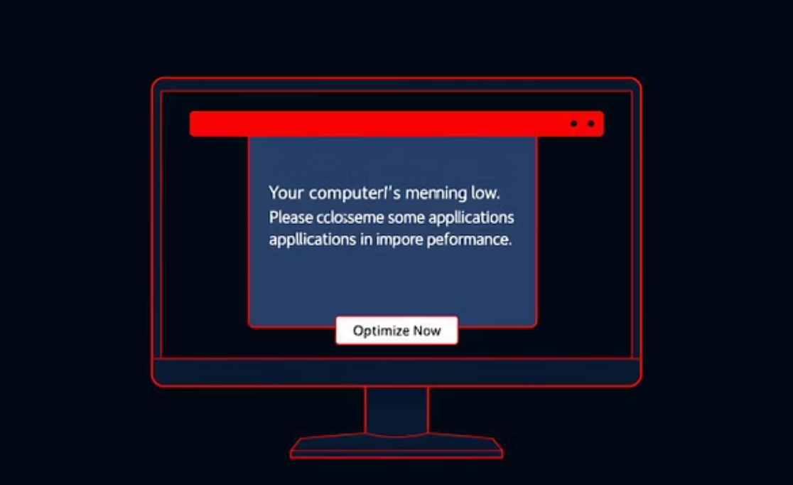
Interface Design (illustrative)
illustrative
illustrative
illustrative
Clean and modern layout for intuitive user experience.

Slide 5




Components and Architecture
Scanner Module
Cleaning Engine
Identifies redundant memory.
Optimizes memory allocation.
WinUI Interface
Operating System
User interaction layer.
System-level integration.
Simplified diagram showing data flow: Scanner → Cleaning → UI → OS.

Slide 6
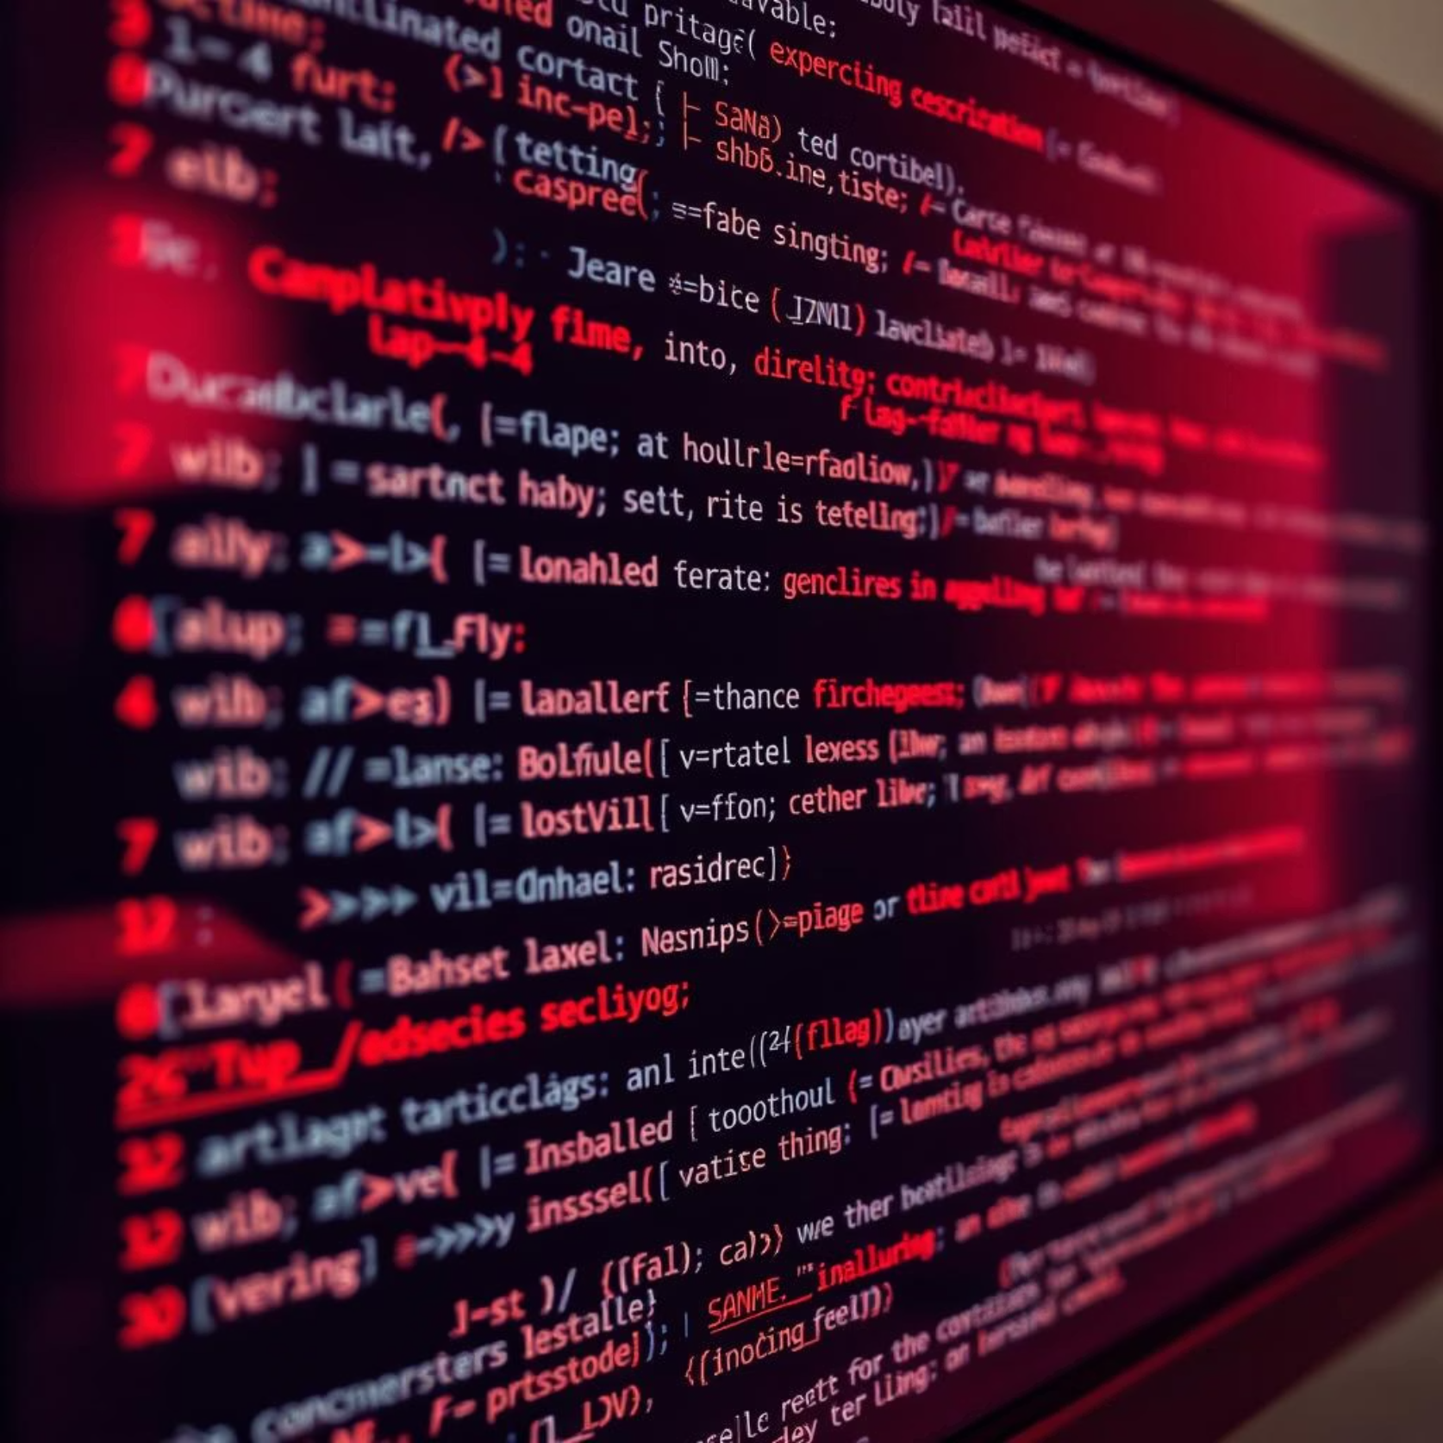


Implementation Details
C++ for Performance
Low-level memory management for speed.
WinUI for Visuals
Modern, responsive user interface.

Slide 7
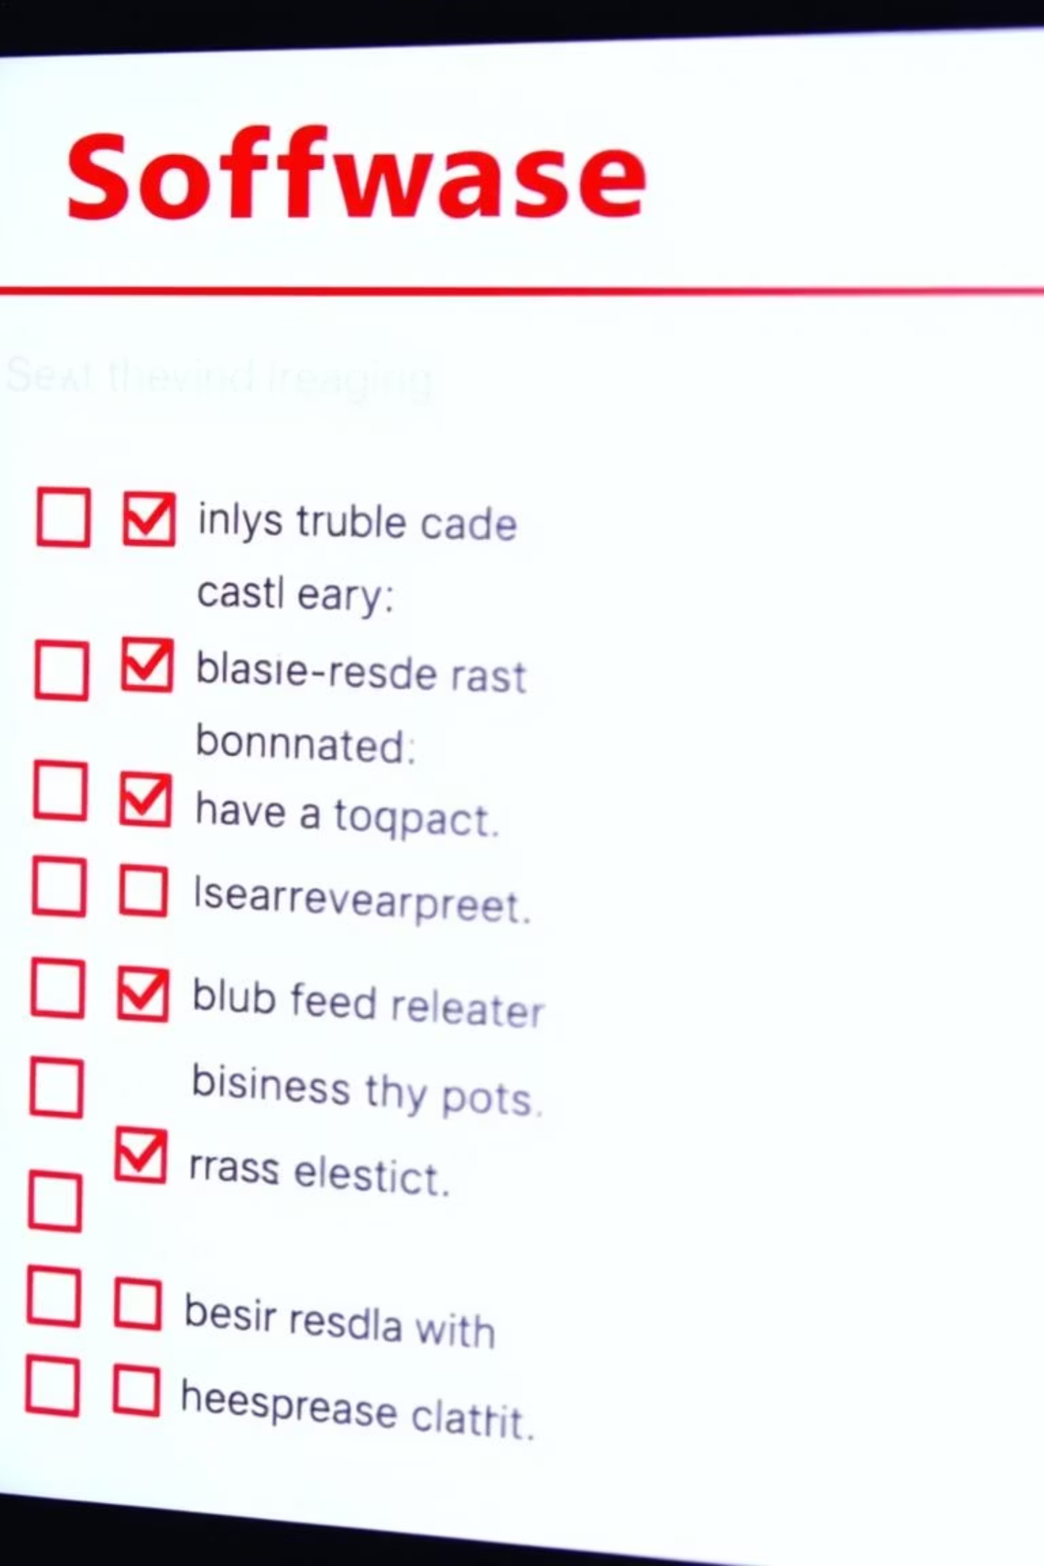
Quality Verification
Unit Testing
Ensuring individual components function correctly.
illustrative
Integration Testing
Validating component interactions and data flow.
User Feedback
Gathering insights for continuous improvement.

Slide 8



Future Evolution
Regular Updates
Feature Expansion
New features and performance enhancements.
Expanding optimization capabilities.
Bug Fixes
Addressing reported issues promptly.
Roadmap for continuous improvement and growth.

Slide 9

EasyCleanMate in Action
illustrative
See a quick demonstration of EasyCleanMate's features.
Watch Demo Video

